Slide 2
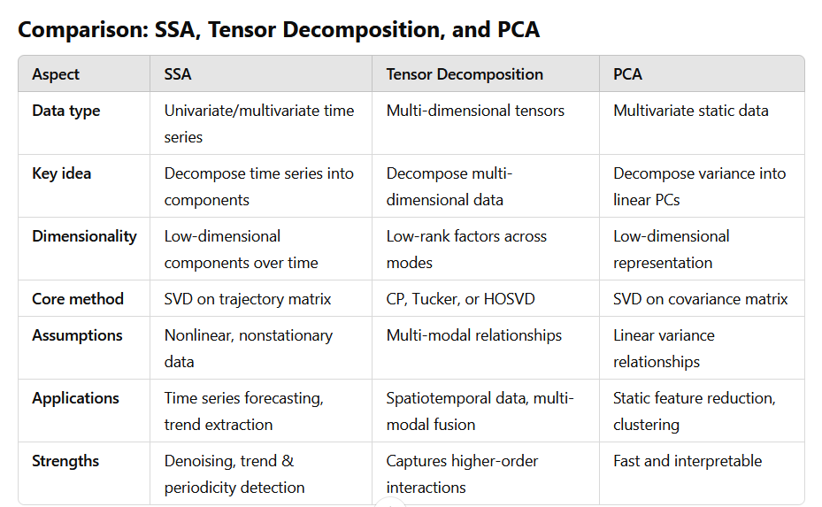

Slide 3
Singular Spectrum Analysis (SSA)
How SSA works:
Decomposition: SSA decomposes a univariate or multivariate time series into components like trend, periodicity, and noise.
The time series is embedded into a trajectory matrix using a sliding window.
Singular Value Decomposition (SVD) is applied to the trajectory matrix.
Reconstruction: Components are selected and reconstructed to extract features or denoise the series.
Similarity to PCA:
Like PCA, SSA uses SVD to project the data into lower-dimensional spaces based on singular values.
Both methods aim to capture variance in the data through principal components (or singular vectors).
Differences from PCA:
SSA is tailored for time series data and involves a temporal embedding process, whereas PCA is a general-purpose tool.
PCA assumes static data matrices, while SSA captures dynamic structures like trends or oscillatory patterns.
SSA doesn't assume linearity in the data, whereas PCA captures linear relationships between variables.
Advantages of SSA:
Effective in denoising and isolating trends and periodicities.
Non-parametric and model-free, requiring no prior assumptions about the data.
Handles nonlinear and nonstationary time series better than PCA.
Use cases for SSA:
Time series forecasting and decomposition.
Extraction of dominant patterns (e.g., seasonal, trend, and cyclic components).
Anomaly detection in univariate time series.

Slide 4
Tensor Decomposition (TD)
How TD works:
Tensors are multi-dimensional generalizations of matrices (e.g., 3D arrays for spatiotemporal data).
Tensor decomposition breaks down tensors into smaller factors (e.g., CANDECOMP/PARAFAC (CP), Tucker decomposition, or Higher-Order SVD (HOSVD)).
The result is a compressed representation that retains key relationships among dimensions.
Similarity to PCA:
Tensor decomposition is a generalization of PCA to higher dimensions (e.g., 3D or more).
Like PCA, it captures dominant patterns or components in the data.
Differences from PCA:
PCA works with 2D matrices, while TD handles multi-dimensional arrays (e.g., spatial-temporal data).
TD captures relationships across multiple modes (e.g., time, location, and variable type), while PCA captures variance in a single mode.
Advantages of TD:
Preserves multi-modal relationships in data, unlike PCA, which collapses multi-dimensional data into 2D.
Offers flexibility with different decomposition models (CP, Tucker, HOSVD).
Useful for large-scale data compression while retaining interpretability.
Use cases for TD:
Spatiotemporal data analysis, such as climate modeling or video analysis.
Feature extraction in multi-modal datasets (e.g., combining text, image, and time series).
Collaborative filtering in recommendation systems.

Slide 5
Advantages and Use Cases
Advantages of SSA:
Best for handling noisy time series and extracting trends.
Works well in applications like financial forecasting, climate patterns, and vibration analysis.
Advantages of Tensor Decomposition:
Efficiently represents large-scale multi-dimensional data.
Works well in spatial-temporal analytics, neuroscience (e.g., EEG analysis), and machine learning for feature extraction from multi-modal data.
Advantages of PCA:
Simple and interpretable.
Ideal for static data with a clear linear structure.
Works well for dimensionality reduction in preprocessing for machine learning.

